Slide 1
CS 484
Introduction to Machine Learning
Week 4, February 11, 2021
Spring Semester 2021

Slide 2
Week 4: Cluster Discovery
K-Mean Clustering
Optimal Number of Clusters
Distance to Chicago
Chapter 4 of the Machine Learning book

Slide 3
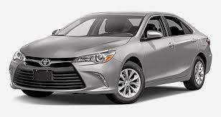

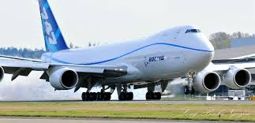
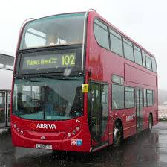
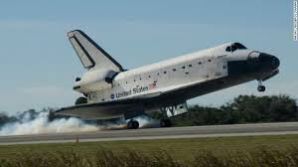
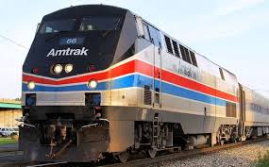
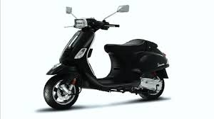
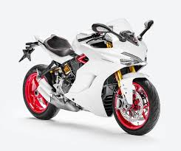




Put These Motorized Vehicles into Groups

Slide 4
Quantitatively, Group By What Criteria?
Physical Attributes
Number of Wheels? 0, 2, 4, …
Weight? 300 lb. (motorcycle) to Infinity
Top Speed? 23 mph (cruise ship) to 17,500 mph (space shuttle)
Maximum Payload? 200 lb. (motorcycle), 50 tons (space shuttle), 248 tons (747), 50,000 tons (cruise ship) to Infinity (freight train)
Socio-Economic Attributes
Number of Passengers? 1, 2, 3, 4, …
Sticker Price? $20,000 (car) to Infinity
Personal Ownership? 0 or 1
Travel Environment? Sea, Land, Air, or Space
Satisfaction of Owning The Vehicle? High, Medium, and Low

Slide 5
Group By Common Sense …
Aerospace Group
Land Group – Four Wheels
Land Group – Many Wheels
Land Group – Two Wheels
Marine Group

Slide 6
What is Cluster Analysis?
Hypothesis – There are Clusters
The observations come from different populations
Usually more than one population
Goals – Identify the Clusters
Objects within the same cluster are as similar as possible
Tasks – Construct the Clusters
Partition the observations into disjoint clusters
Similar observations are put into the same cluster
Objects from different clusters are as dissimilar as possible

Slide 7
What is a Cluster?
Short Answer: a cluster is a collection of observations.
Statistician: A cluster is a collection of observations that have similar characteristics or values of attributes.
Subject Matter Expert: A cluster is a gathering of observations that share some common business values that are reflected by their similar characteristics of attributes.

Slide 8
How to Find Clusters?
How to measure “similarity”?
How to assign observations into clusters?
How to determine the number of clusters?

Slide 9
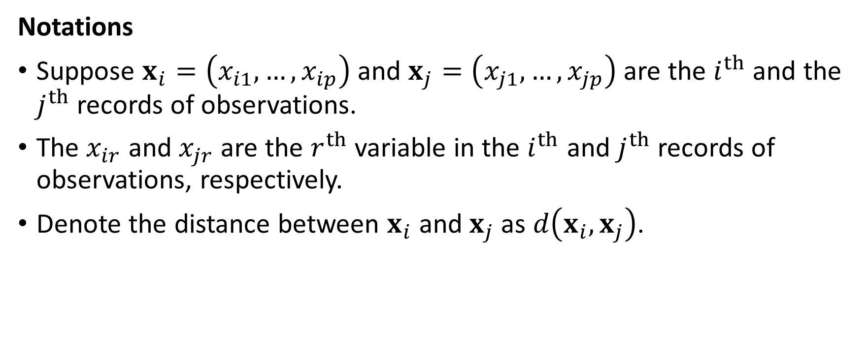
Measure Similarity with Distance Metric
Notations
Suppose $x_{i}=\left(x_{i1},…,x_{ip}\right)$ and $x_{j}=\left(x_{j1},…,x_{jp}\right)$ are the $i^{th}$ and the $j^{th}$records of observations.
The $x_{ir}$ and $x_{jr}$ are the $r^{th}$ variable in the $i^{th}$ and $j^{th}$records of observations, respectively.
Denote the distance between $x_{i}$ and $x_{j}$ as $d\left(x_{i},x_{j}\right)$.

Slide 10
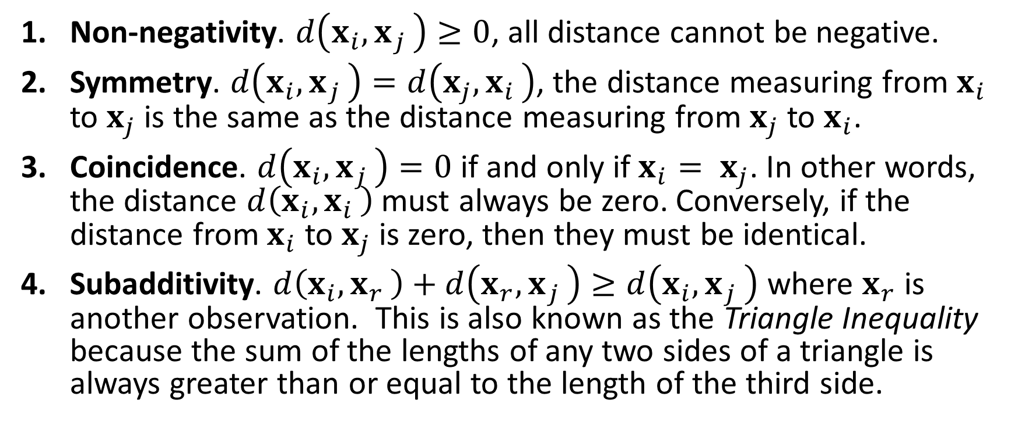
Four Requirements for Distance Metric
Non-negativity. $d\left(x_{i}{, x}_{j}\right)≥0$, all distance cannot be negative.
Symmetry. $d\left(x_{i}{, x}_{j}\right)=d\left(x_{j}{, x}_{i}\right)$, the distance measuring from $x_{i}$ to $x_{j}$ is the same as the distance measuring from $x_{j}$ to $x_{i}$.
Coincidence. $d\left(x_{i}{, x}_{j}\right)=0$ if and only if $x_{i}{= x}_{j}$. In other words, the distance $d\left(x_{i}{, x}_{i}\right)$ must always be zero. Conversely, if the distance from $x_{i}$ to $x_{j}$ is zero, then they must be identical.
Subadditivity. $d\left(x_{i}{, x}_{r}\right)+d\left(x_{r}{, x}_{j}\right)≥d\left(x_{i}{, x}_{j}\right)$ where $x_{r}$ is another observation. This is also known as the Triangle Inequality because the sum of the lengths of any two sides of a triangle is always greater than or equal to the length of the third side.

Slide 11
Common Distance Metrics
Euclidean
Manhattan
Chebyshev
Cosine

Slide 12
Rescale Interval Variables, if Desired
Standardize
The transformation is: (value – mean) / (standard deviation).
The resulting variable has a mean of zero and a variance of one.
Centers of clusters will be scattered around zero.
Range
The transformation is: (value – minimum) / (maximum minimum).
The resulting variable has a minimum of zero and a maximum of one.
Variations within clusters will be bounded within [0, 1]

Slide 13
Represent Clusters: Centroids
A centroid represents the center of a cluster
A centroid gives us a summary about a cluster
Centroids are usually the arithmetic means of the interval variables
If we can visualize a cluster as two-dimensional ellipse, then the centroid of the cluster is the center of the ellipse.
X

Slide 14
Identify Clusters: Cluster Identifier
Clusters are sequentially labeled from 1 to the number of clusters (or from 0 to one less than the number of clusters)
The Cluster Identifiers are merely integers
Disclaimer: The Cluster Identifiers do not indicate the discovery order of the clusters, the relative magnitudes of the centroids, or any relationships among the clusters

Slide 15
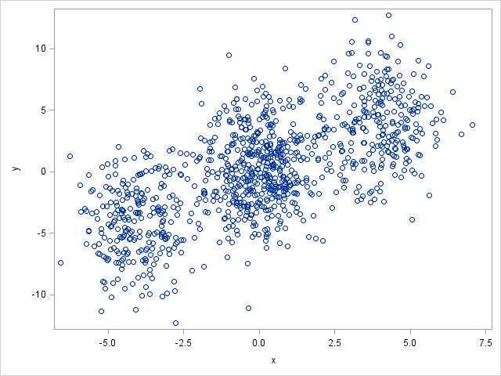
The Basic Idea of the K-Means Algorithm
Assign observations into non-overlapping hyperspheres
The radii of hyper-spheres are as small as possible
Each observation must belong to one and only one hyper-sphere

Slide 16
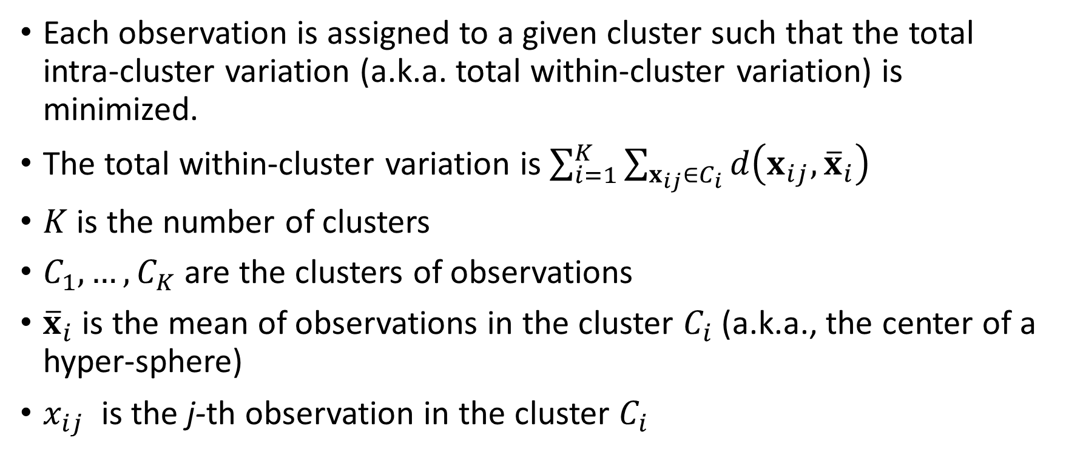
The Basic Idea of the K-Means Algorithm
Each observation is assigned to a given cluster such that the total intra-cluster variation (a.k.a. total within-cluster variation) is minimized.
The total within-cluster variation is $\sum_{i=1}^{K}{\sum_{x_{ij}∈C_{i}}{d\left(x_{ij},{\overline{x}}_{i}\right)}}$
$K$ is the number of clusters
$C_{1},…,C_{K}$ are the clusters of observations
${\overline{x}}_{i}$ is the mean of observations in the cluster $C_{i}$ (a.k.a., the center of a hyper-sphere)
$x_{ij}$ is the j-th observation in the cluster $C_{i}$

Slide 17
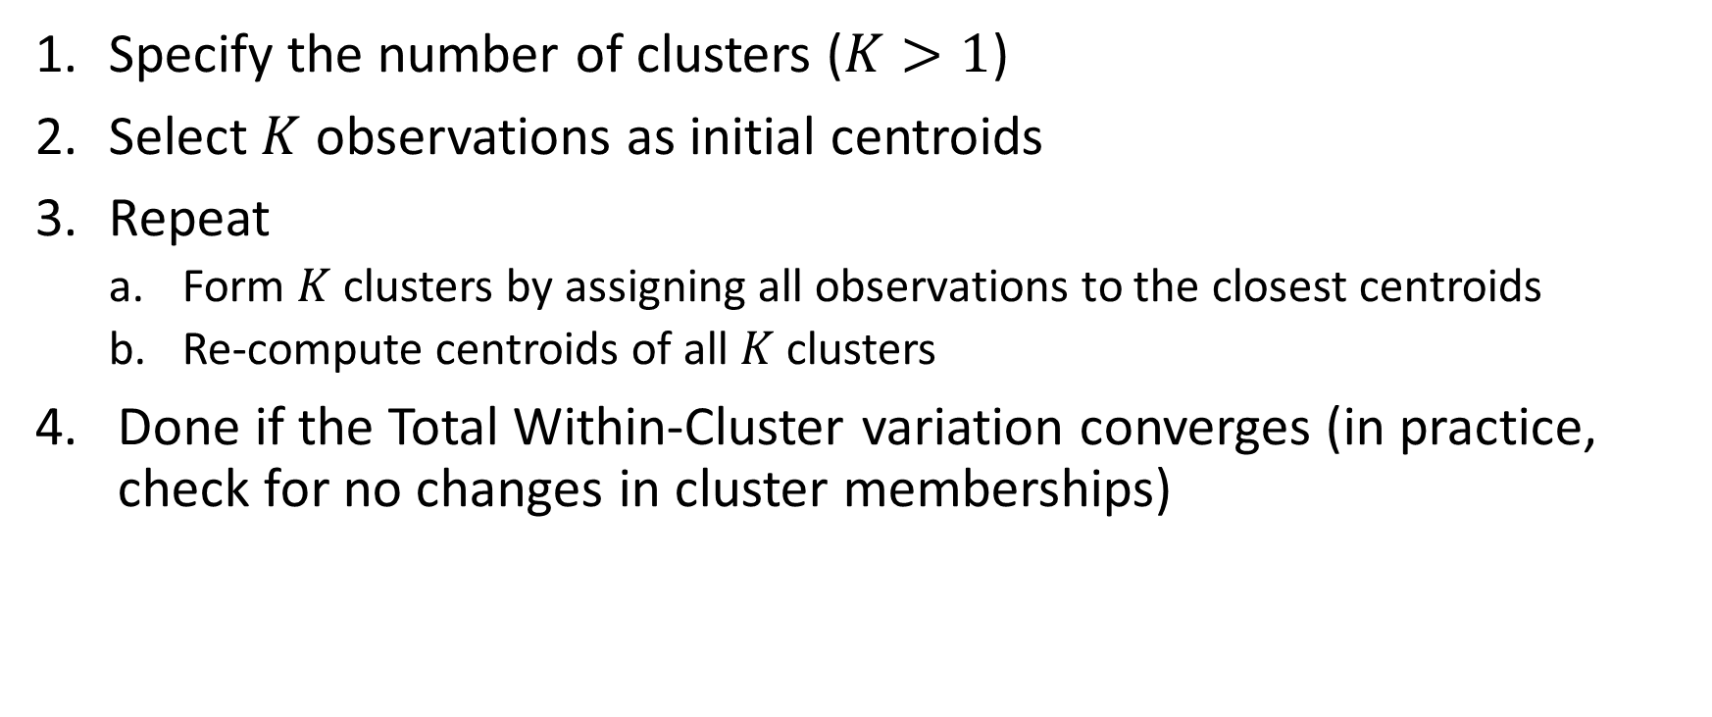
Summary of the K-Means Algorithm
Specify the number of clusters ($K>1$)
Select $K$ observations as initial centroids
Repeat
Form $K$ clusters by assigning all observations to the closest centroids
Re-compute centroids of all $K$ clusters
Done if the Total Within-Cluster variation converges (in practice, check for no changes in cluster memberships)

Slide 18
Cluster Analysis: Initial Centroids
Common strategies for choosing the initial centroids
Scan the first K complete records and use their values as initial centroids (i.e., first complete record’s values are the first cluster’s initial centroid, and so on)
Randomly choose K complete records and use their values as initial centroids (used by the sklearn.cluster.Kmeans)
In theory, the choice of the initial centroids should not affect the resulting centroids. It may, however, impact the number of iterations.

Slide 19
History of the K-Means Algorithm
K-means is often referred to as Lloyd’s algorithm.
Lloyd, S. P. (1957). "Least square quantization in PCM". Bell Telephone Laboratories Paper.
Pulse-code modulation (PCM) is a method used to digitally represent sampled analog signals.
Republished later as Lloyd., S. P. (1982). "Least squares quantization in PCM”. IEEE Transactions on Information Theory. 28 (2): 129–137.
Forgy, E. W. (1965). "Cluster analysis of multivariate data: efficiency versus interpretability of classifications". Biometrics. 21: 768–769.
Hartigan, J. A., and Wong, M. A. (1979). “Algorithm AS 136: A K-Means Clustering Algorithm”. Applied Statistics. 28(1): 100-108.

Slide 20
Simple Example
Five observations in ascending order: 0.1, 0.3, 0.4, 0.8, and 0.9
Find the two clusters solution using the Euclidean distance
For one dimension, this distance is simply the absolute difference
Iteration 1:
Initial centroids: C1 = 0.1, C2 = 0.3
Distance from C1: 0, 0.2, 0.3, 0.7, and 0.8 (WCSS = 0)
Distance from C2: 0.2, 0, 0.1, 0.5, and 0.6 (WCSS = 0² + 0.1² + 0.5² + 0.6² = 0.62)
Total WCSS = 0.62
Cluster membership: 1, 2, 2, 2, 2
New centroid: C1 = 0.1, C2 = (0.3+0.4+0.8+0.9)/4 = 0.6

Slide 21
Simple Example
Five observations: 0.1, 0.3, 0.4, 0.8, and 0.9
Find the two clusters solution using the Euclidean distance
Iteration 2:
Initial centroids: C1 = 0.1, C2 = 0.6
Distance from C1: 0, 0.2, 0.3, 0.7, and 0.8 (WCSS = 0.04)
Distance from C2: 0.5, 0.3, 0.2, 0.2, and 0.3 (WCSS = 0.17)
Total WCSS = 0.21
Cluster membership: 1, 1, 2, 2, 2
New centroid: C1 = (0.1+0.3)/2 = 0.2, C2 = (0.4+0.8+0.9)/3 = 0.7

Slide 22
Simple Example
Five observations: 0.1, 0.3, 0.4, 0.8, and 0.9
Find the two clusters solution using the Euclidean distance
Iteration 3:
Initial centroids: C1 = 0.2, C2 = 0.7
Distance from C1: 0.1, 0.1, 0.2, 0.6, and 0.7 (WCSS = 0.06)
Distance from C2: 0.6, 0.4, 0.3, 0.1, and 0.2 (WCSS = 0.05)
Total WCSS = 0.11
Cluster membership: 1, 1, 1, 2, 2
New centroid: C1 = (0.1+0.3+0.4)/3 = 0.267, C2 = (0.8+0.9)/2 = 0.85

Slide 23
Simple Example
Five observations: 0.1, 0.3, 0.4, 0.8, and 0.9
Find the two clusters solution using the Euclidean distance
Iteration 4:
Initial centroids: C1 = 0.267, C2 = 0.85
Distance from C1: 0.167, 0.003, 0.133, 0.533, and 0.633 (WCSS = 0.0467)
Distance from C2: 0.75, 0.55, 0.45, 0.05, and 0.05 (WCSS = 0.005)
Total WCSS = 0.051667
Cluster membership: 1, 1, 1, 2, 2
New centroid: C1 = (0.1+0.3+0.4)/3 = 0.267, C2 = (0.8+0.9)/2 = 0.85
Iteration ends because the centroids converged and there are no changes in cluster memberships

Slide 24
Simple Example
import numpy
import sklearn.cluster as cluster
# Specify as a 2-dimensional array to meet the KMeans requirements
X = numpy.array([[0.1], [0.3], [0.4], [0.8], [0.9]])
# Find the 2-cluster solution
kmeans = cluster.KMeans(n_clusters = 2, random_state = None).fit(X)
print("Cluster Assignment:", kmeans.labels_)
print("Cluster Centroid 0:", kmeans.cluster_centers_[0])
print("Cluster Centroid 1:", kmeans.cluster_centers_[1])
Random = None lets Python chooses seed
Cluster Assignment: [0 0 0 1 1]
Cluster Centroid 0: [0.26666667]
Cluster Centroid 1: [0.85]

Slide 25
K-Means Algorithm (Observations’ Order)
Five observations in random order: 0.8, 0.3, 0.1, 0.4, and 0.9
Find the two clusters solution using the Euclidean distance
Iteration 1:
Initial centroids: C1 = 0.8, C2 = 0.3
Distance from C1: 0, 0.5, 0.7, 0.4, and 0.1 (WCSS = 0.01)
Distance from C2: 0.5, 0, 0.2, 0.1, and 0.6 (WCSS = 0.05)
Total WCSS = 0.06
Cluster membership: 1, 2, 2, 2, 1
New centroid: C1 = (0.8 + 0.9) = 0.85, C2 = (0.3+0.1+0.4)/3 = 0.2667

Slide 26
K-Means Algorithm
Five observations in random order: 0.8, 0.3, 0.1, 0.4, and 0.9
Find the two clusters solution using the Euclidean distance
Iteration 2:
Initial centroids: C1 = 0.85, C2 = 0.2667
Distance from C1: 0.05, 0.55, 0.75, 0.45, and 0.05 (WCSS = 0.005)
Distance from C2: 0.5333, 0.0333, 0.1667, 0.1333, and 0.6333 (WCSS = 0.04667)
Total WCSS = 0.05167
Cluster membership: 1, 2, 2, 2, 1
New centroid: C1 = (0.8 + 0.9) = 0.85, C2 = (0.3+0.1+0.4)/3 = 0.2667
Iteration ends because the centroids converged and there are no changes in cluster memberships.

Slide 27
What is the Number of Clusters?
Preferably, what is the optimal number of clusters?
This is necessary information which we usually do not know.
So, we will consider the number of clusters from a range of integers (greater than one) and find an optimal value based on some selection criteria.
The Elbow Method
The Silhouette Index
The Calinski-Harabasz Score
The Davies-Bouldin Index

Slide 28
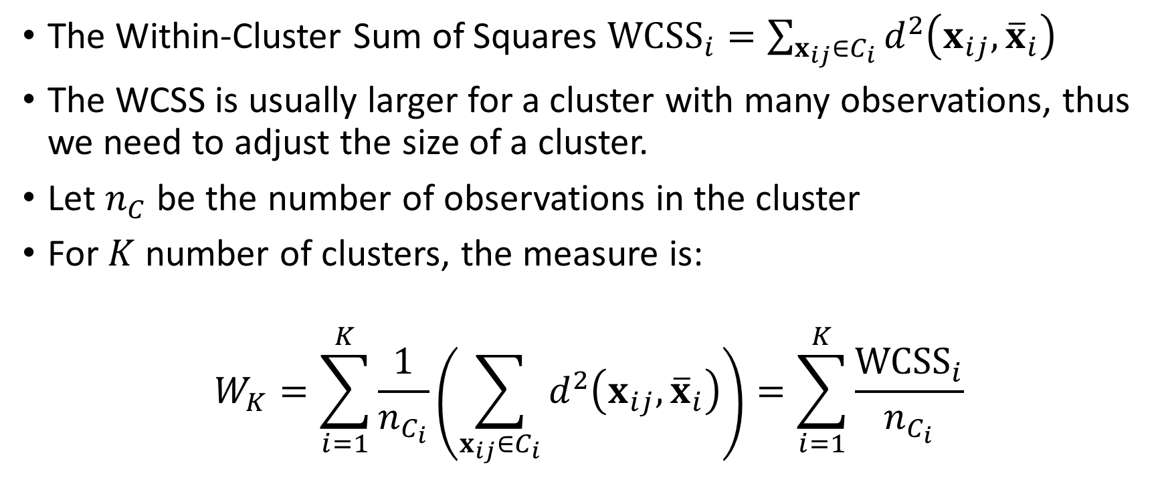
The Elbow Method
The Within-Cluster Sum of Squares ${WCSS}_{i}=\sum_{x_{ij}∈C_{i}}{d^{2}\left(x_{ij},{\overline{x}}_{i}\right)}$
The WCSS is usually larger for a cluster with many observations, thus we need to adjust the size of a cluster.
Let $n_{C}$ be the number of observations in the cluster
For $K$ number of clusters, the measure is:
$$W_{K}=\sum_{i=1}^{K}{\frac{1}{n_{C_{i}}}\left(\sum_{x_{ij}∈C_{i}}{d^{2}\left(x_{ij},{\overline{x}}_{i}\right)}\right)=\sum_{i=1}^{K}{\frac{{WCSS}_{i}}{n_{C_{i}}}}}$$

Slide 29
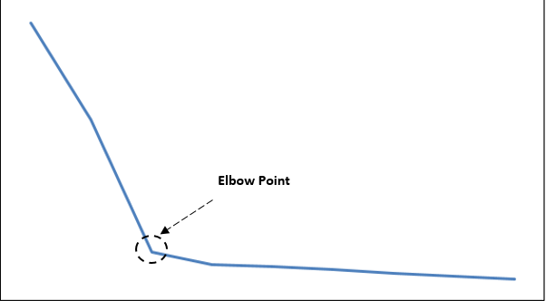
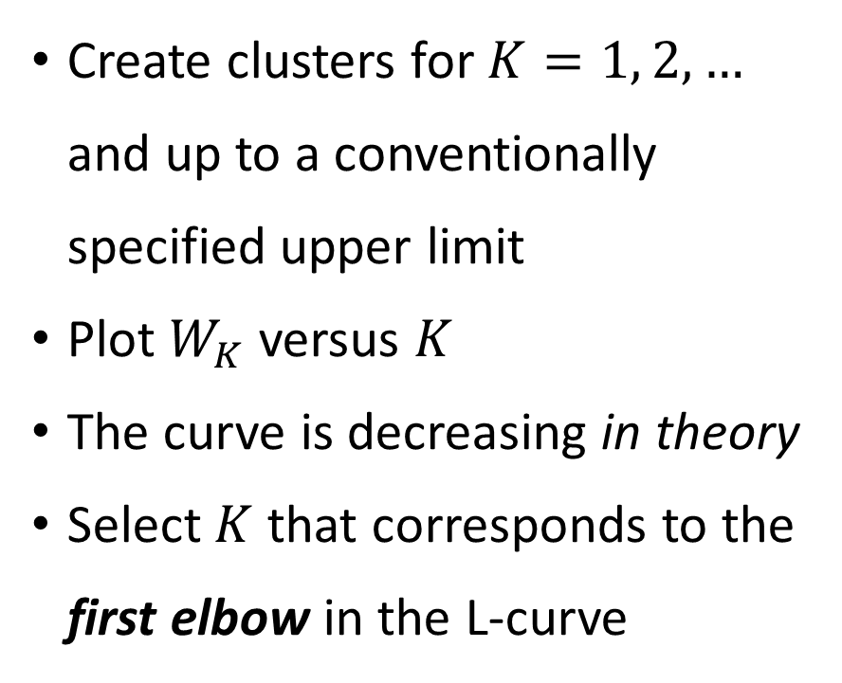
The Elbow Method
Create clusters for $K=1, 2, …$ and up to a conventionally specified upper limit
Plot $W_{K}$ versus $K$
The curve is decreasing in theory
Select $K$ that corresponds to the first elbow in the L-curve

Slide 30
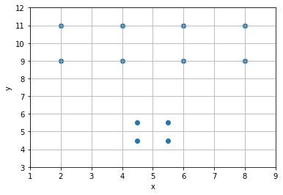
How Many Clusters Are There?
x | y
2 | 11
4 | 11
2 | 9
4 | 9
6 | 11
8 | 11
6 | 9
8 | 9
4.5 | 5.5
5.5 | 5.5
5.5 | 4.5
4.5 | 4.5

Slide 31
One-Clusters Solution …
Centroids
Cluster | x | y | Size
0 | 5 | 25/3 | 12
The centroid of the One-Cluster solution is basically the means of the variables

Slide 32
One-Clusters Solution …
x | y | Cluster | Centroid | Squared Euclidean Distance From Centroid | WCSS | WCSS / Cluster Size
2 | 11 | 0 | (5, 25/3) | 16.111111 | 116.66667 | 9.7222222
4 | 11 | 0 |  | 8.1111111
2 | 9 | 0 |  | 9.4444444
4 | 9 | 0 |  | 1.4444444
6 | 11 | 0 |  | 8.1111111
8 | 11 | 0 |  | 16.111111
6 | 9 | 0 |  | 1.4444444
8 | 9 | 0 |  | 9.4444444
4.5 | 5.5 | 0 |  | 8.2777778
5.5 | 5.5 | 0 |  | 8.2777778
5.5 | 4.5 | 0 |  | 14.944444
4.5 | 4.5 | 0 |  | 14.944444
Total |  |  |  |  | 116.66667 | 9.7222222

Slide 33
Two-Clusters Solution …
Centroids
Cluster | x | y | Size
0 | 5 | 10 | 8
1 | 5 | 5 | 4

Slide 34
Two-Clusters Solution …
x | y | Cluster | Centroid | Squared Euclidean Distance From Centroid | WCSS | WCSS / Cluster Size
2 | 11 | 0 | (5,10) | 10 | 48 | 6
4 | 11 | 0 |  | 2
2 | 9 | 0 |  | 10
4 | 9 | 0 |  | 2
6 | 11 | 0 |  | 2
8 | 11 | 0 |  | 10
6 | 9 | 0 |  | 2
8 | 9 | 0 |  | 10
4.5 | 5.5 | 1 | (5,5) | 0.5 | 2 | 0.5
5.5 | 5.5 | 1 |  | 0.5
5.5 | 4.5 | 1 |  | 0.5
4.5 | 4.5 | 1 |  | 0.5
Total |  |  |  |  | 50 | 6.5

Slide 35
Three-Clusters Solution …
Centroids
Cluster | x | y | Size
0 | 3 | 10 | 4
1 | 5 | 5 | 4
2 | 7 | 10 | 4

Slide 36
Three-Clusters Solution …
x | y | Cluster | Centroid | Squared Euclidean Distance From Centroid | WCSS | WCSS / Cluster Size
2 | 11 | 0 | (3,10) | 2 | 8 | 2
4 | 11 | 0 |  | 2
2 | 9 | 0 |  | 2
4 | 9 | 0 |  | 2
6 | 11 | 2 | (7,10) | 2 | 8 | 2
8 | 11 | 2 |  | 2
6 | 9 | 2 |  | 2
8 | 9 | 2 |  | 2
4.5 | 5.5 | 1 | (5,5) | 0.5 | 2 | 0.5
5.5 | 5.5 | 1 |  | 0.5
5.5 | 4.5 | 1 |  | 0.5
4.5 | 4.5 | 1 |  | 0.5
Total |  |  |  |  | 18 | 4.5

Slide 37
Four-Clusters Solution …
Centroids
Cluster | x | y | Size
0 | 5 | 5 | 4
1 | 6 | 10 | 2
2 | 3 | 10 | 4
3 | 8 | 10 | 2

Slide 38
Four-Clusters Solution …
x | y | Cluster | Centroid | Squared Euclidean Distance From Centroid | WCSS | WCSS / Cluster Size
2 | 11 | 2 | (3,10) | 2 | 8 | 2
4 | 11 | 2 |  | 2
2 | 9 | 2 |  | 2
4 | 9 | 2 |  | 2
6 | 9 | 1 | (6,10) | 1 | 2 | 1
6 | 11 | 1 |  | 1
8 | 9 | 3 | (8,10) | 1 | 2 | 1
8 | 11 | 3 |  | 1
4.5 | 5.5 | 0 | (5,5) | 0.5 | 2 | 0.5
5.5 | 5.5 | 0 |  | 0.5
5.5 | 4.5 | 0 |  | 0.5
4.5 | 4.5 | 0 |  | 0.5
Total |  |  |  |  | 14 | 4.5

Slide 39
Five-Clusters Solution …
Centroids
Cluster | x | y | Size
0 | 5 | 5 | 4
1 | 6 | 10 | 2
2 | 2 | 10 | 2
3 | 8 | 10 | 2
4 | 4 | 10 | 2

Slide 40
Six-Clusters Solution …
Centroids
Cluster | x | y | Size
0 | 4 | 10 | 2
1 | 5 | 5 | 4
2 | 6 | 10 | 2
3 | 2 | 10 | 2
4 | 8 | 11 | 1
4 | 8 | 9 | 1

Slide 41
Summary
Number of Clusters | Within-Cluster Sum of Squares | Elbow Value
1 | 116.6667 | 9.7222
2 | 50 | 6.5
3 | 18 | 4.5
4 | 14 | 4.5
5 | 10 | 4.5
6 | 8 | 3.5

Slide 42
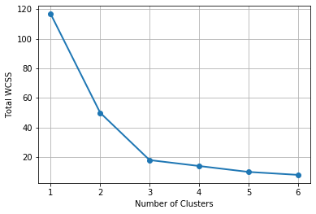
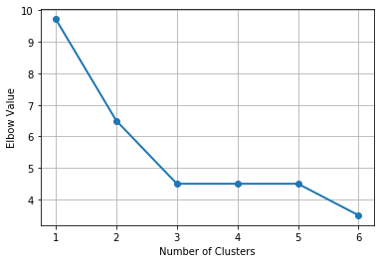
Within-Cluster-SS versus Elbow Value
The elbow is the point where the slope changes substantially. We can spot that point easier in the Elbow chart.

Slide 43


The Silhouette Index
Ideally, observations within a cluster should be close together but they should be far away from other clusters.

Slide 44
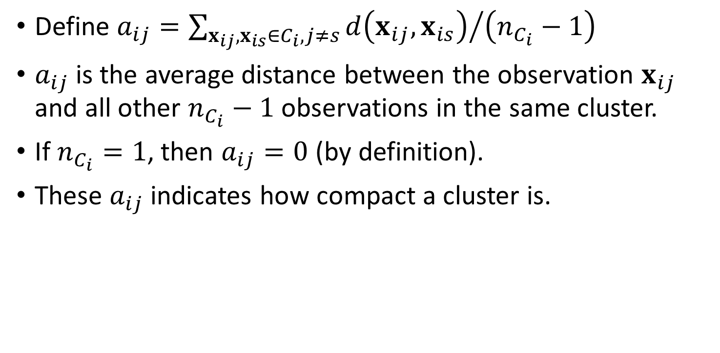
The Silhouette Index
Define $a_{ij}={\sum_{x_{ij},x_{is}∈C_{i},j≠s}{d\left(x_{ij},x_{is}\right)}}/{\left(n_{C_{i}}−1\right)}$
$a_{ij}$is the average distance between the observation $x_{ij}$ and all other $n_{C_{i}}−1$ observations in the same cluster.
If $n_{C_{i}}=1$, then $a_{ij}=0$ (by definition).
These $a_{ij}$ indicates how compact a cluster is.

Slide 45

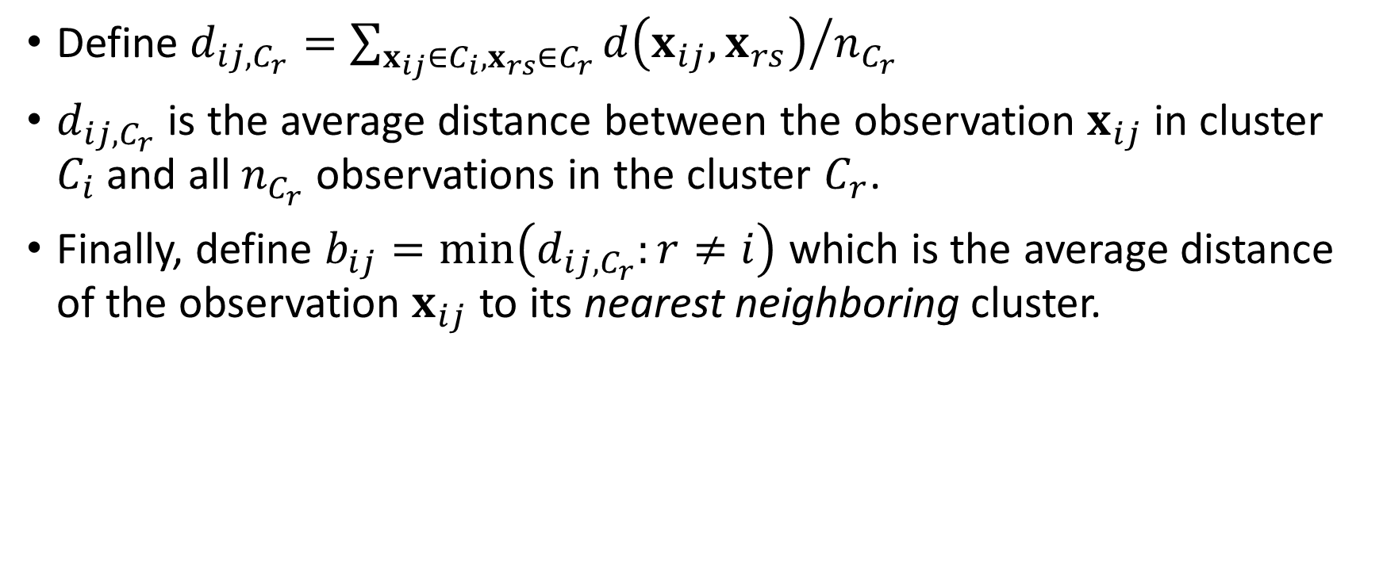
The Silhouette Index
Define $d_{ij,C_{r}}={\sum_{x_{ij}∈C_{i},x_{rs}∈C_{r}}{d\left(x_{ij},x_{rs}\right)}}/{n_{C_{r}}}$
$d_{ij,C_{r}}$ is the average distance between the observation $x_{ij}$ in cluster $C_{i}$and all $n_{C_{r}}$observations in the cluster $C_{r}$.
Finally, define $b_{ij}=min\left(d_{ij,C_{r}}:r≠i\right)$ which is the average distance of the observation $x_{ij}$ to its nearest neighboring cluster.

Slide 46
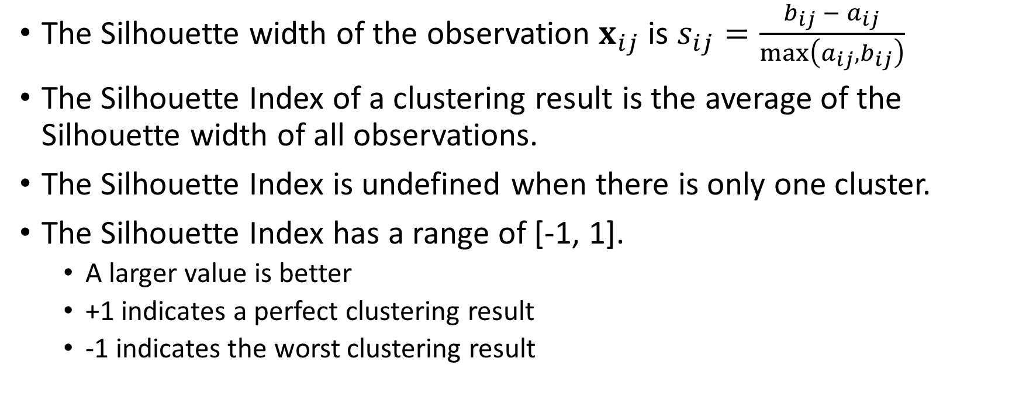
The Silhouette Index
The Silhouette width of the observation $x_{ij}$ is $s_{ij}=\frac{b_{ij} − a_{ij}}{max\left(a_{ij},b_{ij}\right)}$
The Silhouette Index of a clustering result is the average of the Silhouette width of all observations.
The Silhouette Index is undefined when there is only one cluster.
The Silhouette Index has a range of [-1, 1].
A larger value is better
+1 indicates a perfect clustering result
-1 indicates the worst clustering result

Slide 47
Two-Clusters Solution …
Centroids
Cluster | x | y | Size
0 | 5 | 10 | 8
1 | 5 | 5 | 4

Slide 48
Two-Clusters Solution …
x | y | Cluster | Euclidean Distance from (2,11) | Sum
2 | 11 | 0 | 0 | 27.6251184 | Divide Sum by (8 – 1) gives a_ij = 3.94644548572608
4 | 11 | 0 | 2
2 | 9 | 0 | 2
4 | 9 | 0 | 2.828427125
6 | 11 | 0 | 4
8 | 11 | 0 | 6
6 | 9 | 0 | 4.472135955
8 | 9 | 0 | 6.32455532
4.5 | 5.5 | 1 | 6.041522987 | 26.90733106 | Divide Sum by 4 gives b_ij = 6.72683276517717
5.5 | 5.5 | 1 | 6.519202405
5.5 | 4.5 | 1 | 7.38241153
4.5 | 4.5 | 1 | 6.964194139

Slide 49
Two-Clusters Solution …
x | y | Cluster | Euclidean Distance from (4.5, 5.5) | Sum
2 | 11 | 0 | 6.041522987 | 40.37861359 | Divide Sum by 8 gives b_ij = 5.047326698
4 | 11 | 0 | 5.522680509
2 | 9 | 0 | 4.301162634
4 | 9 | 0 | 3.535533906
6 | 11 | 0 | 5.700877125
8 | 11 | 0 | 6.519202405
6 | 9 | 0 | 3.807886553
8 | 9 | 0 | 4.949747468
4.5 | 5.5 | 1 | 0 | 3.414213562 | Divide Sum by (4 – 1) gives a_ij = 1.138071187
5.5 | 5.5 | 1 | 1
5.5 | 4.5 | 1 | 1.414213562
4.5 | 4.5 | 1 | 1

Slide 50
Two-Clusters Solution …
Some b_ij values in Cluster 1 are less than that in Cluster 0 ➔ Cluster 0 may be divided
x | y | Cluster | a_ij | b_ij | s_ij
2 | 11 | 0 | 3.946445486 | 6.726832765 | 0.413327843
4 | 11 | 0 | 2.875570029 | 6.103398018 | 0.528857528
2 | 9 | 0 | 3.946445486 | 5.024900574 | 0.214622175
4 | 9 | 0 | 2.875570029 | 4.15363238 | 0.307697512
6 | 11 | 0 | 2.875570029 | 6.103398018 | 0.528857528
8 | 11 | 0 | 3.946445486 | 6.726832765 | 0.413327843
6 | 9 | 0 | 2.875570029 | 4.15363238 | 0.307697512
8 | 9 | 0 | 3.946445486 | 5.024900574 | 0.214622175
4.5 | 5.5 | 1 | 1.138071187 | 5.047326698 | 0.774520007
5.5 | 5.5 | 1 | 1.138071187 | 5.047326698 | 0.774520007
5.5 | 4.5 | 1 | 1.138071187 | 5.95705517 | 0.808954063
4.5 | 4.5 | 1 | 1.138071187 | 5.95705517 | 0.808954063
 |  |  |  | Silhouette Value = | 0.507996521
Cluster 1 has smaller a_ij values than Cluster 0 ➔ Cluster 1 is more compact than Cluster 0

Slide 51
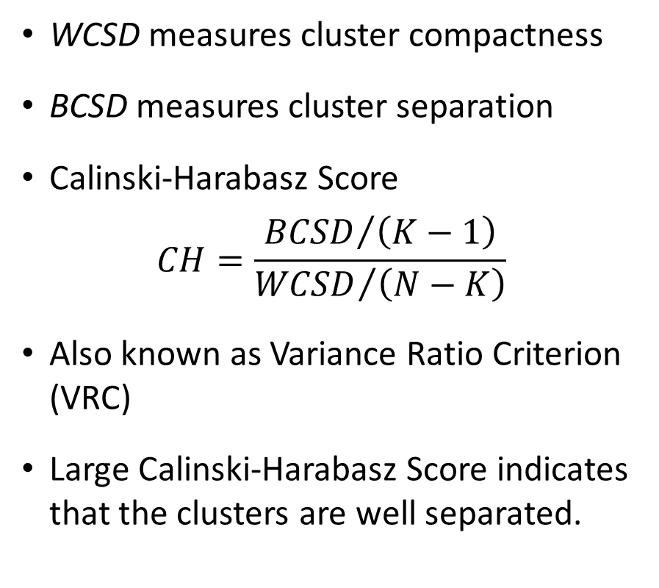
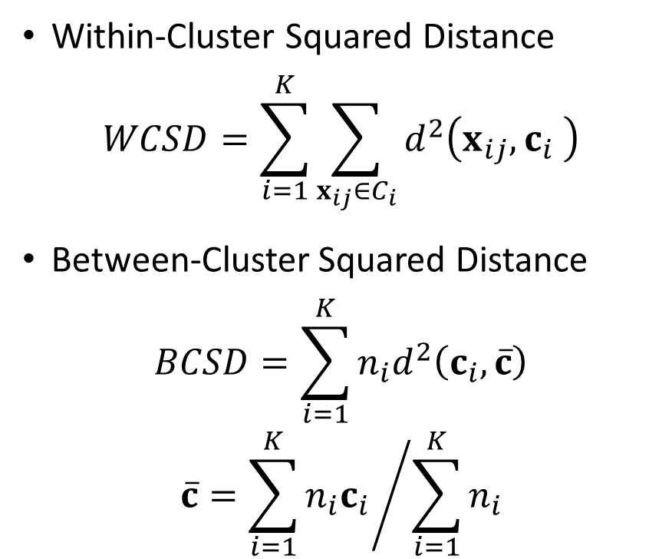
The Calinski-Harabasz Score
Within-Cluster Squared Distance
$$WCSD=\sum_{i=1}^{K}{\sum_{x_{ij}∈C_{i}}{d^{2}\left(x_{ij},c_{i} \right)}}$$
Between-Cluster Squared Distance
$$BCSD=\sum_{i=1}^{K}{n_{i}d^{2}\left(c_{i},\overline{c}\right)}$$
$$\overline{c}={\sum_{i=1}^{K}{{n_{i}c}_{i}}}/{\sum_{i=1}^{K}{n_{i}}}$$
WCSD measures cluster compactness
BCSD measures cluster separation
Calinski-Harabasz Score
$$CH=\frac{{BCSD}/{\left(K−1\right)}}{{WCSD}/{\left(N−K\right)}}$$
Also known as Variance Ratio Criterion (VRC)
Large Calinski-Harabasz Score indicates that the clusters are well separated.

Slide 52
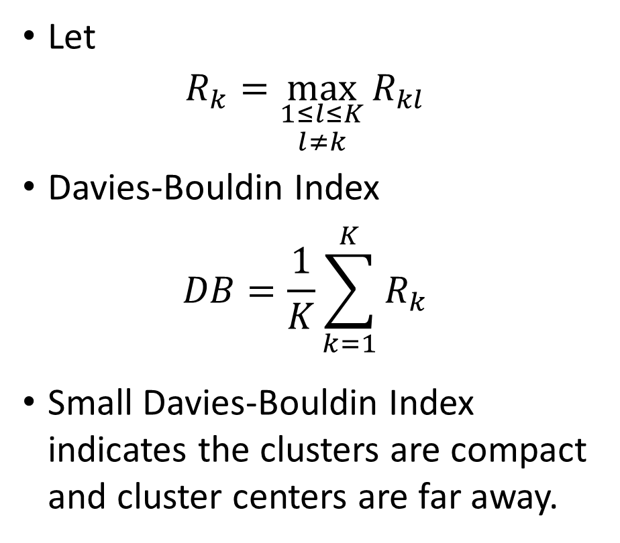
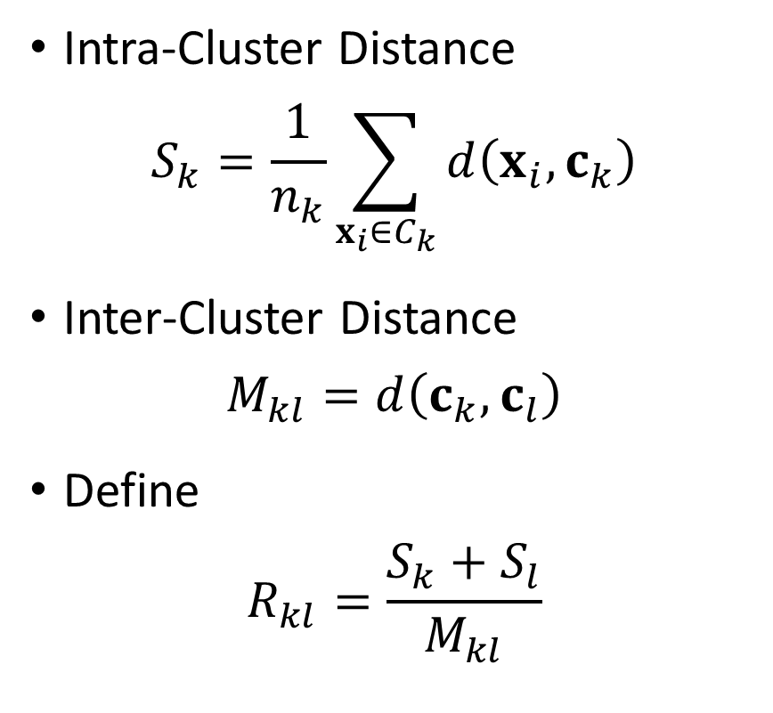
The Davies-Bouldin Index
Intra-Cluster Distance
$$S_{k}=\frac{1}{n_{k}}\sum_{x_{i}∈C_{k}}{d\left(x_{i},c_{k}\right)}$$
Inter-Cluster Distance
$$M_{kl}=d\left(c_{k},c_{l}\right)$$
Define
$$R_{kl}=\frac{S_{k}+S_{l}}{M_{kl}}$$
Let
$$R_{k}=\max_{\begin{aligned}1≤l≤K \\ l≠k\end{aligned}}{R_{kl}}$$
Davies-Bouldin Index
$$DB=\frac{1}{K}\sum_{k=1}^{K}{R_{k}}$$
Small Davies-Bouldin Index indicates the clusters are compact and cluster centers are far away.

Slide 53
Summary
Number of Clusters | Within-Cluster Sum of Squares | Elbow Value | Silhouette Value | Calinski-Harabasz Score | Davies-Bouldin Index
1 | 116.6667 | 9.7222 | Undefined | Undefined | Undefined
2 | 50 | 6.5 | 0.5080 | 13.3333 | 0.5991
3 | 18 | 4.5 | 0.5515 | 24.6667 | 0.6027
4 | 14 | 4.5 | 0.4025 | 19.5556 | 0.7997
5 | 10 | 4.5 | 0.3715 | 18.6667 | 0.8670
6 | 8 | 3.5 | 0.3119 | 16.3000 | 0.7049

Slide 54
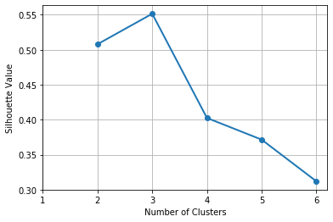
Elbow Value versus Silhouette Value
Week 4 Toy KMeans.py
Except for noisy data, both the Elbow Chart and the Silhouette Chart will conclude the same “number of clusters”

Slide 55
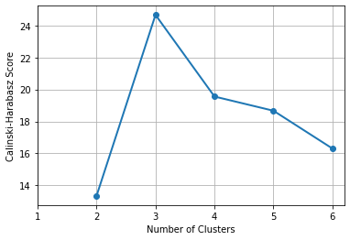
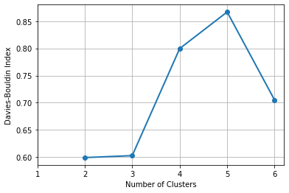
Calinski-Harabasz Score, Davies-Bouldin Index
Week 4 Toy KMeans.py
Calinski-Harabasz Score suggests three clusters
Although Davies-Bouldin Index suggests two clusters, this index is close to that of the three clusters.

Slide 56
Clusters of Distances From Chicago
CityState | StateCode | City | DrivingMilesFromChicago |  | CityState | StateCode | City | DrivingMilesFromChicago
Albany, NY | NY | Albany | 820 |  | Little Rock, AR | AR | Little Rock | 655
Albuquerque, NM | NM | Albuquerque | 1341 |  | Los Angeles, CA | CA | Los Angeles | 2028
Atlanta, GA | GA | Atlanta | 712 |  | Louisville, KY | KY | Louisville | 297
Baltimore, MD | MD | Baltimore | 704 |  | Memphis, TN | TN | Memphis | 536
Billings, MT | MT | Billings | 1247 |  | Miami, FL | FL | Miami | 1373
Birmingham, AL | AL | Birmingham | 661 |  | Milwaukee, WI | WI | Milwaukee | 92
Boise, ID | ID | Boise | 1702 |  | Minneapolis, MN | MN | Minneapolis | 407
Boston, MA | MA | Boston | 986 |  | Nashville, TN | TN | Nashville | 472
Buffalo, NY | NY | Buffalo | 531 |  | New Orleans, LA | LA | New Orleans | 927
Charleston, WV | WV | Charleston | 484 |  | New York, NY | NY | New York | 811
Charleston, SC | SC | Charleston | 911 |  | Norfolk, VA | VA | Norfolk | 891
Charlotte, NC | NC | Charlotte | 770 |  | Oklahoma City, OK | OK | Oklahoma City | 796
Cheyenne, WY | WY | Cheyenne | 968 |  | Omaha, NE | NE | Omaha | 469
Cleveland, OH | OH | Cleveland | 342 |  | Orlando, FL | FL | Orlando | 1152
Columbia, SC | SC | Columbia | 802 |  | Philadelphia, PA | PA | Philadelphia | 761
Columbus, OH | OH | Columbus | 352 |  | Phoenix, AZ | AZ | Phoenix | 1804
Dallas, TX | TX | Dallas | 933 |  | Pittsburgh, PA | PA | Pittsburgh | 460
Denver, CO | CO | Denver | 1009 |  | Portland, ME | ME | Portland | 1087
Des Moines, IA | IA | Des Moines | 333 |  | Portland, OR | OR | Portland | 2122
Detroit, MI | MI | Detroit | 278 |  | Rapid City, SD | SD | Rapid City | 909
EL Paso, TX | TX | EL Paso | 1488 |  | Reno, NV | NV | Reno | 1924
Fargo, ND | ND | Fargo | 644 |  | Saint Louis, MO | MO | Saint Louis | 300
Grand Junction, CO | CO | Grand Junction | 1252 |  | Salt Lake City, UT | UT | Salt Lake City | 1404
Hartford, CT | CT | Hartford | 903 |  | San Antonio, TX | TX | San Antonio | 1210
Houston, TX | TX | Houston | 1089 |  | San Diego, CA | CA | San Diego | 2088
Indianapolis, IN | IN | Indianapolis | 179 |  | San Francisco, CA | CA | San Francisco | 2148
Jackson, MS | MS | Jackson | 747 |  | Seattle, WA | WA | Seattle | 2070
Jacksonville, FL | FL | Jacksonville | 1058 |  | Washington, DC | DC | Washington | 705
Kansas City, MO | MO | Kanas City | 529 |  | Wichita, KS | KS | Wichita | 725
Las Vegas, NV | NV | Las Vegas | 1755
Data
DistanceFromChicago.csv
Clustering
Discover up to 15 clusters
Week 4 Distance From Chicago.py
Driving distances (in miles) from Chicago to 59 cities

Slide 57
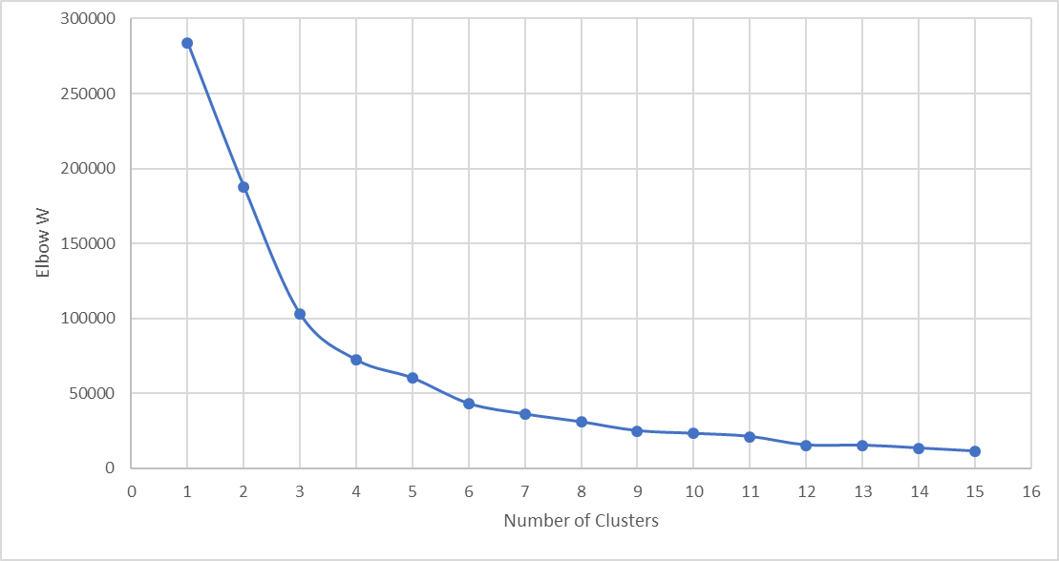
Clusters of Distances From Chicago
Number of Clusters | Elbow W
1 | 283894.49470
2 | 187758.44330
3 | 102762.12850
4 | 72117.19284
5 | 59977.70978
6 | 43009.44740
7 | 35976.15443
8 | 30744.71677
9 | 24872.10349
10 | 23059.31235
11 | 21039.24087
12 | 15339.02335
13 | 15204.20374
14 | 13337.71644
15 | 11278.23727

Slide 58
Clusters of Distances From Chicago
Number of Clusters | Elbow W | Slope | Acceleration
1 | 283894.49470
2 | 187758.44330 | -96136.05
3 | 102762.12850 | -84996.31 | 11139.74
4 | 72117.19284 | -30644.94 | 54351.38
5 | 59977.70978 | -12139.48 | 18505.45
6 | 43009.44740 | -16968.26 | -4828.78
7 | 35976.15443 | -7033.29 | 9934.97
8 | 30744.71677 | -5231.44 | 1801.86
9 | 24872.10349 | -5872.61 | -641.18
10 | 23059.31235 | -1812.79 | 4059.82
11 | 21039.24087 | -2020.07 | -207.28
12 | 15339.02335 | -5700.22 | -3680.15
13 | 15204.20374 | -134.82 | 5565.40
14 | 13337.71644 | -1866.49 | -1731.67
15 | 11278.23727 | -2059.48 | -192.99
Largest Acceleration (i.e., change of slope)

Slide 59
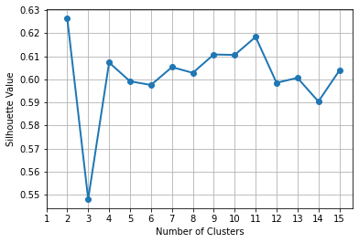
Clusters of Distances From Chicago
Number of Clusters | Silhouette Value
1
2 | 0.6264
3 | 0.5481
4 | 0.6073
5 | 0.5991
6 | 0.5975
7 | 0.6053
8 | 0.6028
9 | 0.6108
10 | 0.6106
11 | 0.6184
12 | 0.5985
13 | 0.6006
14 | 0.5904
15 | 0.6038

Slide 60
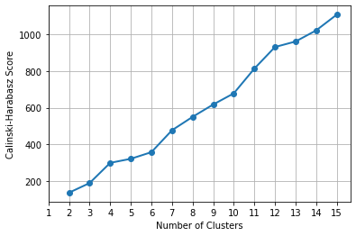
Clusters of Distances From Chicago
Number of Clusters | Calinski-Harabasz Score
1
2 | 135.7099
3 | 188.3643
4 | 298.7964
5 | 320.9637
6 | 357.1838
7 | 476.9584
8 | 550.1409
9 | 617.6819
10 | 678.6652
11 | 813.9098
12 | 931.9576
13 | 962.0584
14 | 1022.7607
15 | 1108.9120
Cannot Determine Number of Clusters!

Slide 61
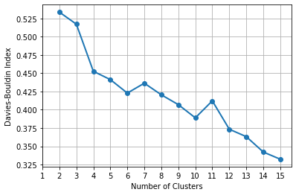
Clusters of Distances From Chicago
Number of Clusters | Davies-Bouldin Index
1
2 | 0.5337
3 | 0.5172
4 | 0.4527
5 | 0.4413
6 | 0.4229
7 | 0.4364
8 | 0.4205
9 | 0.4070
10 | 0.3890
11 | 0.4122
12 | 0.3734
13 | 0.3632
14 | 0.3422
15 | 0.3323
Cannot Determine Number of Clusters!

Slide 62
Describe the Four-Cluster Solution
Cluster 0 |  | Cluster 1 | Cluster 2 | Cluster 3
Size = 23 |  | 9 | 16 | 11
Centroid = 815.2 miles |  | 1,960.1 | 378.8 | 1,245.5
WCSS = 280,147.9 mile² |  | 228,916. 9 | 255,120.4 | 204,122.7
Albany, NY Atlanta, GA Baltimore, MD Birmingham, AL Boston, MA Charleston, SC Charlotte, NC Cheyenne, WY Columbia, SC Dallas, TX Denver, CO Fargo, ND Hartford, CT Jackson, MS Little Rock, AR New Orleans, LA | New York, NY Norfolk, VA Oklahoma City, OK Philadelphia, PA Rapid City, SD Washington, DC Wichita, KS | Boise, ID Las Vegas, NV Los Angeles, CA Phoenix, AZ Portland, OR Reno, NV San Diego, CA San Francisco, CA Seattle, WA | Buffalo, NY Charleston, WV Cleveland, OH Columbus, OH Des Moines, IA Detroit, MI Indianapolis, IN Kansas City, MO Louisville, KY Memphis, TN Milwaukee, WI Minneapolis, MN Nashville, TN Omaha, NE Pittsburgh, PA Saint Louis, MO | Albuquerque, NM Billings, MT EL Paso, TX Grand Junction, CO Houston, TX Jacksonville, FL Miami, FL Orlando, FL Portland, ME Salt Lake City, UT San Antonio, TX

Slide 63
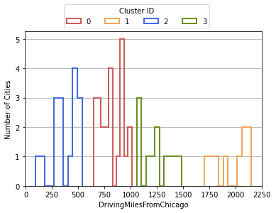
Visualize How Well Clusters are Separated
Cluster 1 is well-separated from the other three clusters.
Cluster 2 is fairly separated from the other three clusters
Cluster 0 and Cluster 3 narrowly separated from each other
Unfilled histogram bars allow for overlapping clusters

Slide 64
Assignment 2
Assignment 2 has been posted
Due date is 11:59 pm on Sunday, February 21, 2021
Submit your answers as a PDF file
Submit your Python codes as .py files, otherwise liable for 50% deduction
Can submit your answers no more than two times
Only the most recently submitted answers will be graded.

